Slide 1
Operation Sequence for Pole 2 Deblock AND Breaker/Filter/Line Maintenance
14 July 2021

Slide 2
Contents
Operation Sequence for
Pole 2 Deblock
AC Filter Sub Bank F1B1 Maintenance
500kV AC CB B1Q1 Maintenance
500kV Lahore South-I Line Maintenance
132kV Line 2 Maintenance

Slide 3
Pole 2 Deblock

Slide 4
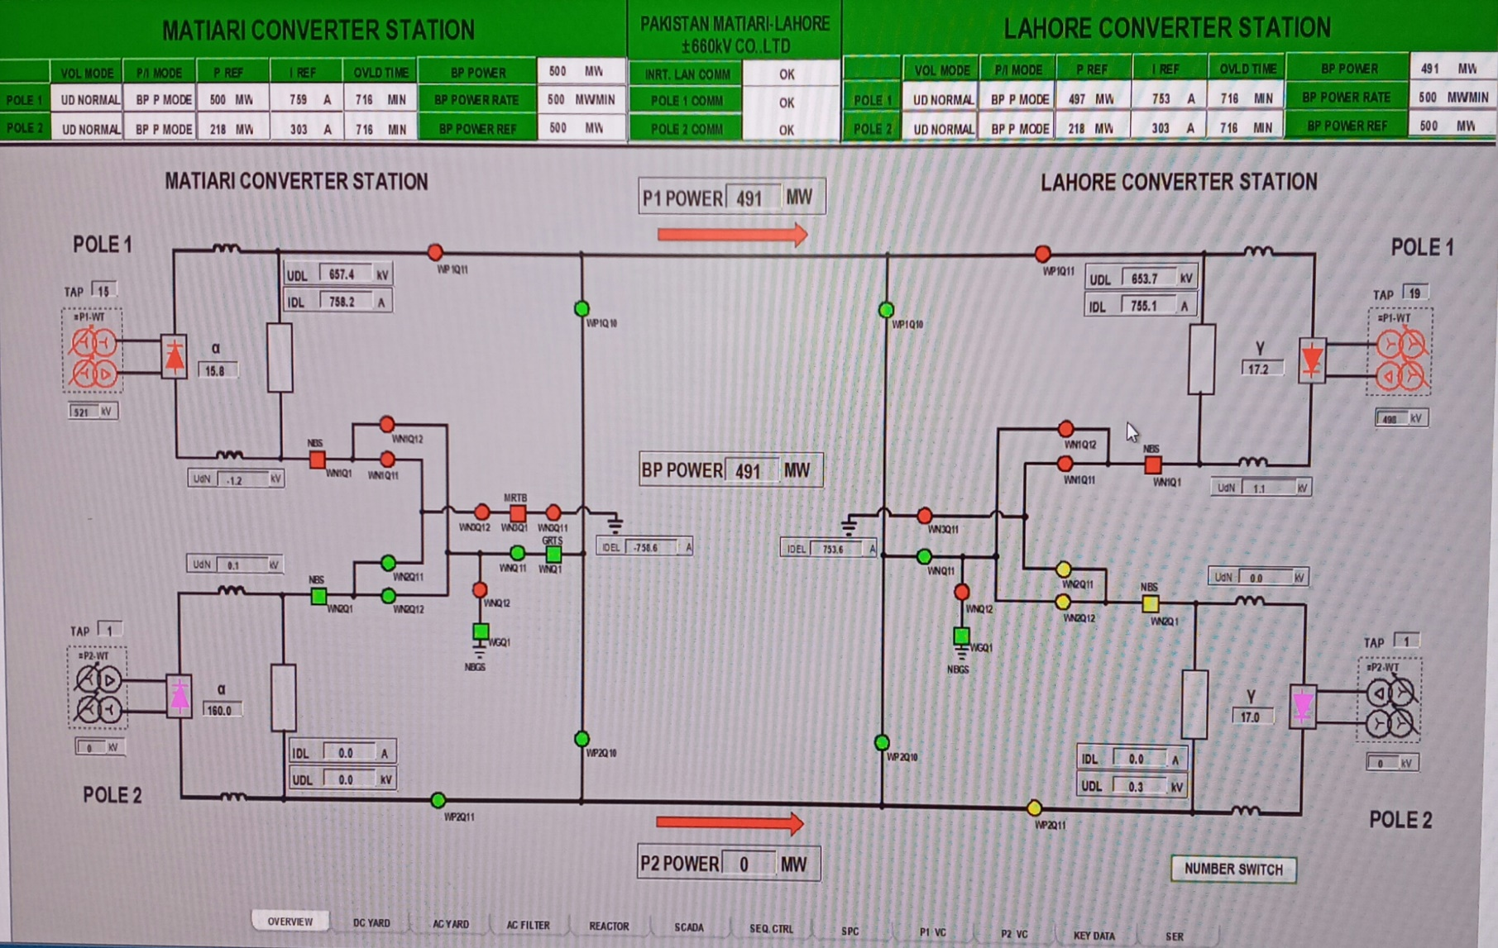
Initial State: Overview
Pole 2 is Blocked. Pole 1 Operates in Ground return Mode
Valve | BLOCKED
Conv. T/F | De-energized
Pole 2 NBS | OPEN
Pole 2 Neutral bus WN2Q11, WN2Q12 | OPEN
Pole 2 bus WP2Q11 | OPEN

Slide 5
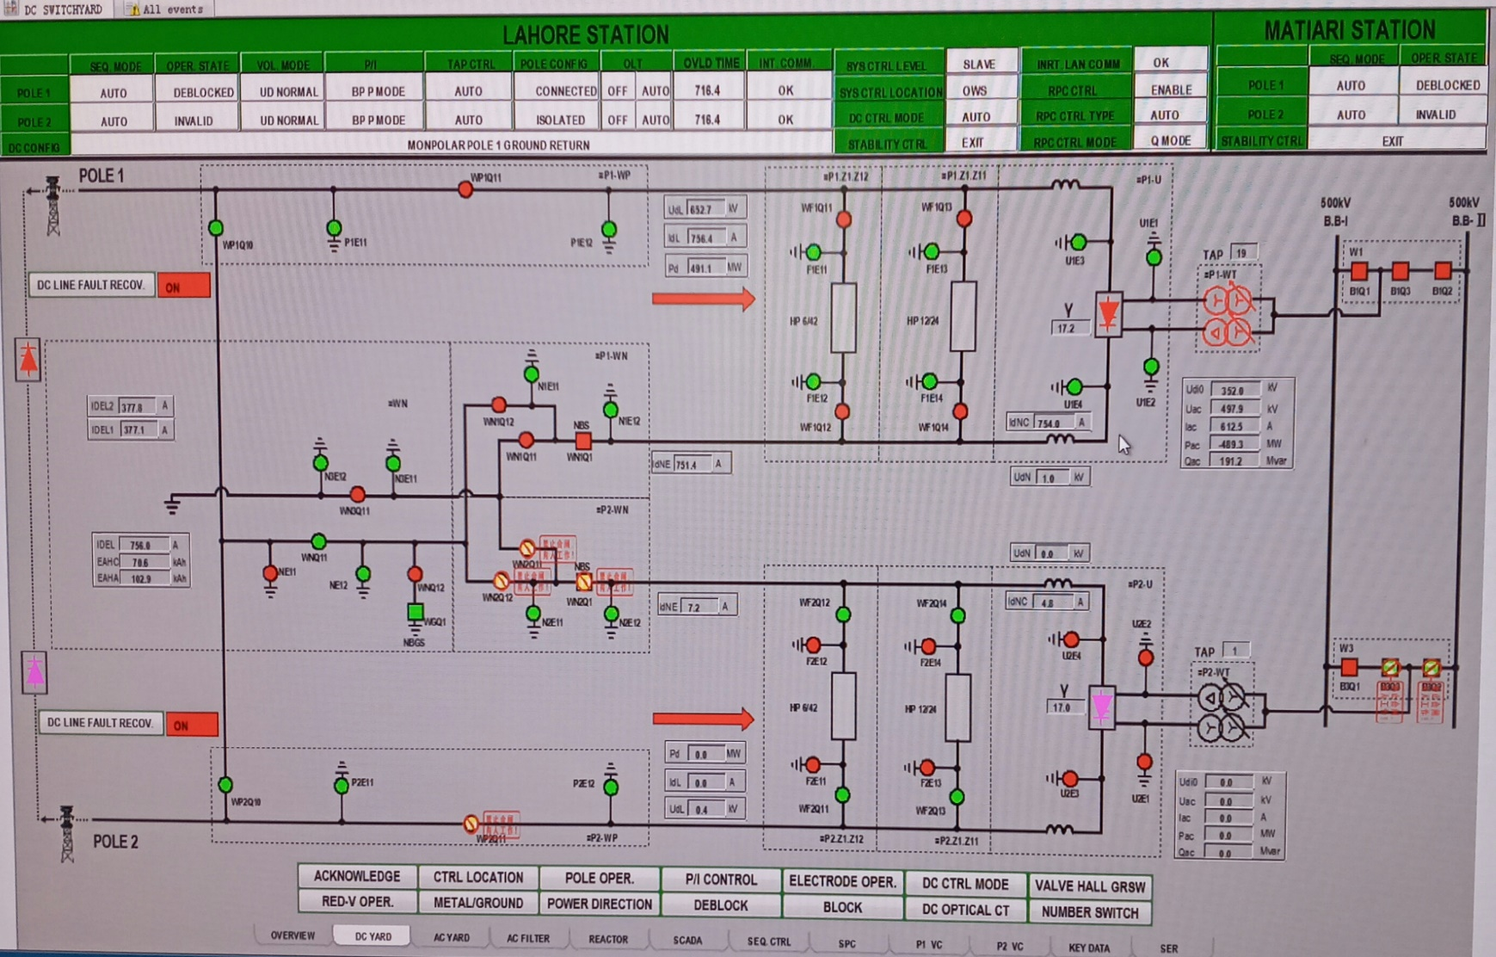
Initial State: DC Yard
Pole 2 Valve is Blocked. Converter T/F is De-Energized
Valve Hall Earth Switches | CLOSED
DC Filter 1 and 2 | Maintenance
Converter Transformer Breakers B3Q2, B3Q3 | OPEN
Pole 2 NBS | OPEN
Pole 2 Neutral bus WN2Q11, WN2Q12 | OPEN
Pole 2 bus WP2Q11 | OPEN

Slide 6
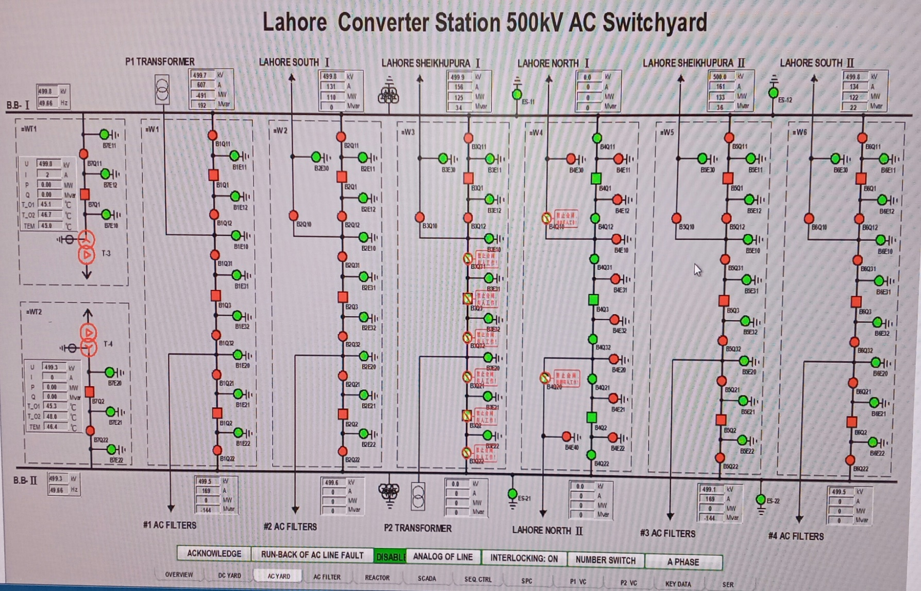
Initial State: AC Yard
Pole 2 Converter T/F is Disconnected from B.B.1 and B.B.2
Pole 2 Converter T/F Breakers B3Q2, B3Q3 | OPEN
Isolators B3Q21, B3Q22, B3Q31, B3Q32 | OPEN
Earth Switches B3E20, B3E21, B3E22, B3E31, B3E32 | OPEN

Slide 7
Switch Interlocking
OPERATION |  | INTERLOCKING CONDITION
P2.WN-Q11 | ON | P2-WN-Q21 OPEN and P2.WN-Q22 OPEN and P2-WP-Q21 OPEN and WN-Q21 OPEN and (S1-WN-Q2 OPEN and WN-Q1 OPEN or P2-WN-Q1 OPEN)
 | OFF | P2-WN-Q1 OPEN
P2.WN-Q12 | ON | P2-WN-Q1 OPEN and P2-WN-Q21 OPEN and P2.WN-Q22 OPEN and P2-WP-Q21 OPEN and WN-Q22 OPEN
 | OFF | P2-WN-Q1 OPEN or WN-Q13 OPEN
P2-WN-Q1 | ON | 1
 | OFF | (P2BLK or P2ESOF) and P2Idne <102.4%
P2-WP-Q11 | ON | P1-WP-Q21 OPEN and P1-WP-Q22 OPEN and P1-WP-Q12 OPEN and P1-WN-Q1 CLOSED and [P1.WN-Q11 CLOSED and WN-Q11 CLOSED and WN-Q1 CLOSED or WN-Q13 CLOSED and P1.WN-Q12 CLOSED and (WN-Q12 OPEN or P2-WP-Q12 OPEN) or P1.WN-Q11 CLOSED and WN-Q12 CLOSED and P2-WP-Q12 CLOSED and WN-Q13 CLOSED] and S1-P1-WP-Q22 OPEN and S1-P1 OLT OFF
 | OFF | P2BLK∧ P2Idl ≤2%

Slide 8
Sequence Control
Equipment and main systems of inverter station | Status
 | Overhaul status | Cold standby state | Hot standby state | Deblock operation state
VCE | / | / | OK | OK
Valve cooling control system | / | Operation | Operation | Operation
Control and protection system | / | / | OK | OK
Interlocking of valve hall key | Release | Locked | Locked | Locked
Earthing switch in valve hall | Closing | Opening | Opening | Opening
Converter transformer incoming line earthing switch | Closing | Opening | Opening | Opening
Converter transformer incoming line circuit breaker | Opening | Opening | Closing | Closing
Converter transformer incoming line disconnector | Opening | Opening | Closing | Closing
Converter transformer tap changer position | / | Start gear | Proper gear | Proper gear
Converter transformer cooling system | / | / | Operation | Operation
DC filter | Earthed | Unearthed | Available | Available
AC filter | Earthed | Unearthed | Available | Available
DC switchyard configuration | Earthed | Unearthed | Connection | Connection

Slide 9
Deblock Sequence
STEP | Sequence description | Monitoring time
STEP0 initialization
STEP10 maintenance state
20 | Lock the valve hall key | 3s
25 | Check the valve hall interlocking | 1s
40 | Open the earthing switch at DC side of valve hall | 3min
40 | Open the earthing switch at AC side of valve hall | 3min
50 | Open the converter transformer incoming line earthing switch | 60s
70 | Tap changer to start gear | 10min
80 | Start of valve cooling system | 30s
STEP200 cold standby state
203 | Check the inter-station communication for normal or in station level | 3s
205 | Start the converter transformer cooling system | 100s
210 | Check the DC filter configuration for normal | 3min
215 | Check the DC switchyard configuration for OK | 30min
217 | Start the smoothing reactor cooling system | 30s
220 | Check that the valve cooling system is ready | 100s
222 | Close the converter transformer incoming line disconnector | 100s
228 | Close the converter transformer incoming line circuit breaker | 30s
240 | Check the DC switchyard configuration for OK | 30min
245 | AC filter available | 30s
248 | Converter transformer tap changer gets ready | 10min
STEP300 hot standby state
315 | Check the AC filter for OK | 2s
318 | Minimum filter enabled | 30s
320 | Start the normal deblock of closed-loop control | 15s
STEP400 deblock operation state

Slide 10
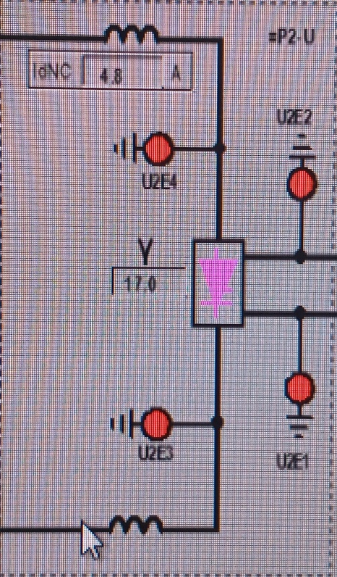
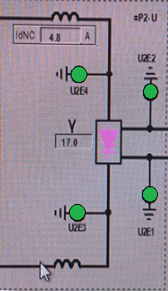
Pole 2 deblock: Step 1
Open Valve Hall Earth Switches. Open U2E1, U2E2, U2E3, U2E4
Open Earthing switch using Operator Workstation Interface. By giving “Valve hall all GRSW Open” command. All the earth switches will open after one command automatically.
Check three-phase switch is indeed open and the position monitoring signal indication is correct. Also check on the video monitoring PC that all the earth switches are open in valve hall physically.

Slide 11
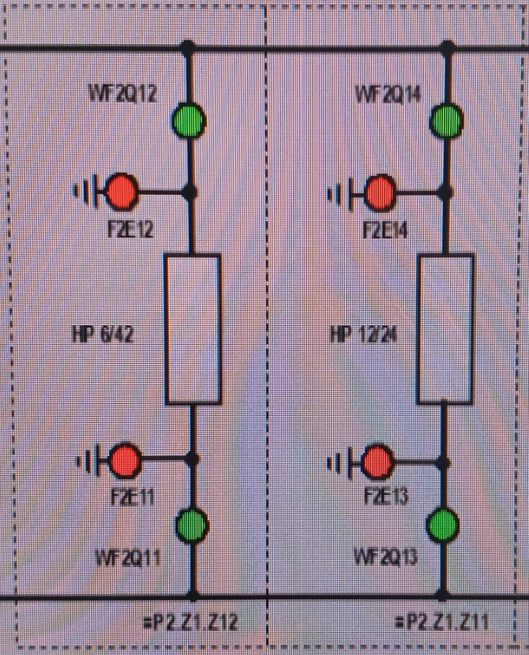
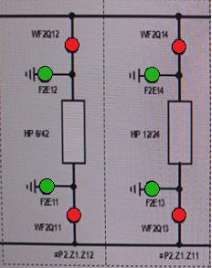
Pole 2 deblock: Step 2
2. Connect DC Filter 1 and 2. Open F2E11, F2E12, F2E13, F2E14. The Isolators WF2Q11, WF2Q12, WF2Q13, WF2Q14 will close automatically
This operation in done by single command for each DC filter. And rest of operation is auto.
For DC Filter 1 “Pole 2 DC Filter-1 Connect” command.
For DC Filter 2 “Pole 2 DC Filter-2 Connect” command.
Check both pole and neutral side earth switch is indeed open and disconnectors are closed. Also the position monitoring signal indication is correct.

Slide 12
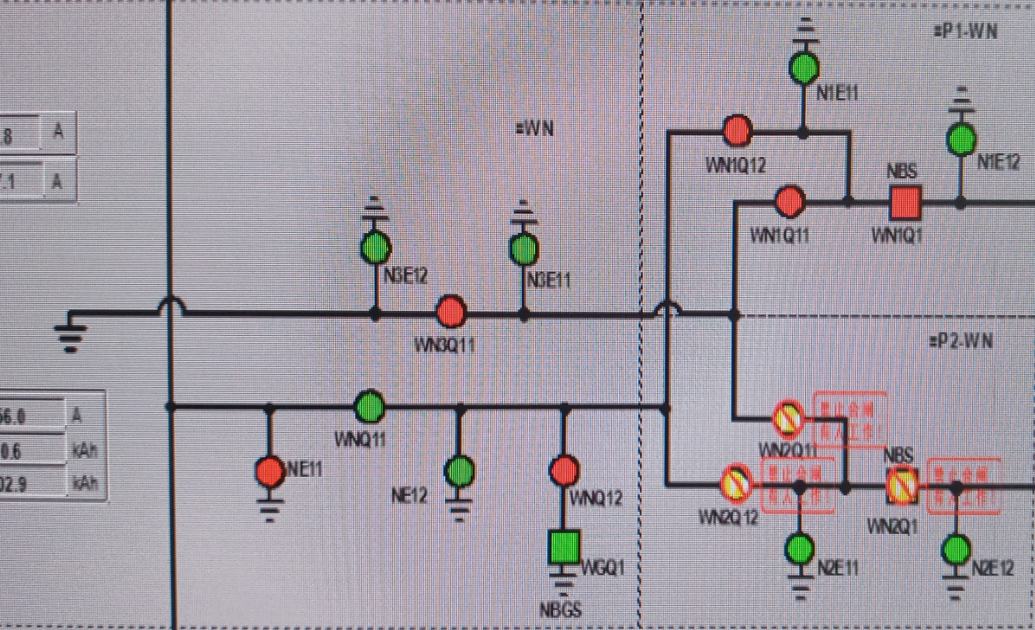
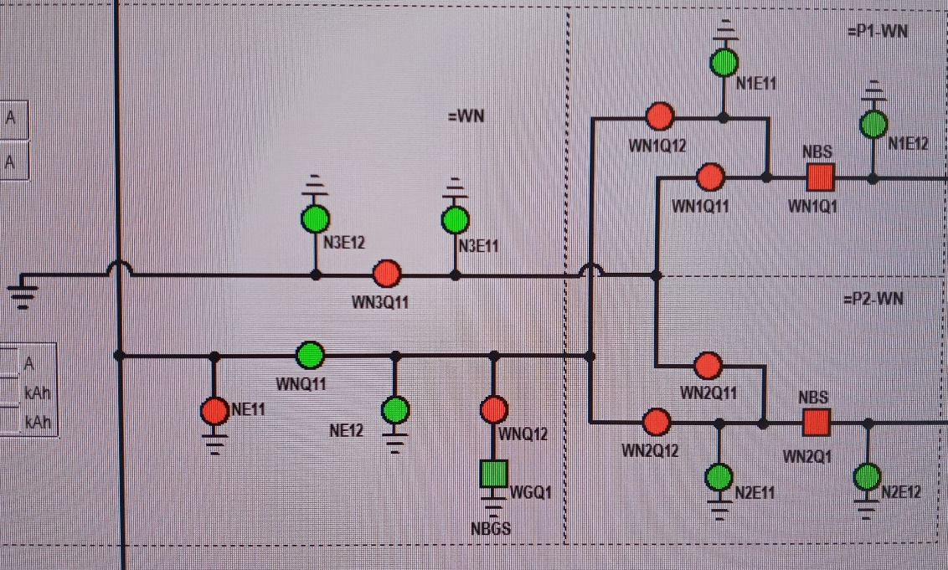
Pole 2 deblock: Step 3
3. Close Pole 2 Neutral Bus Switches WN2Q11, WN2Q12. The Circuit Breaker WN2Q1 will close Automatically.
This operation is done by single command of “DC Sequence connect P2” command.
Check all switches are indeed closed and the position monitoring signal indication is correct

Slide 13
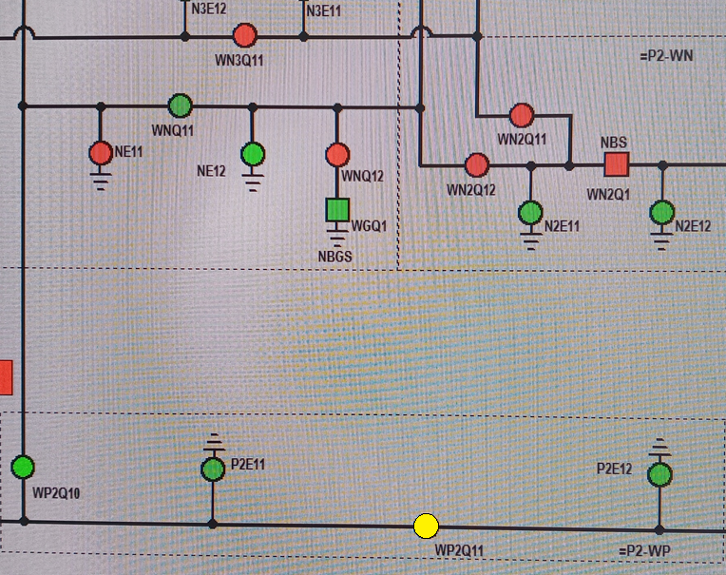
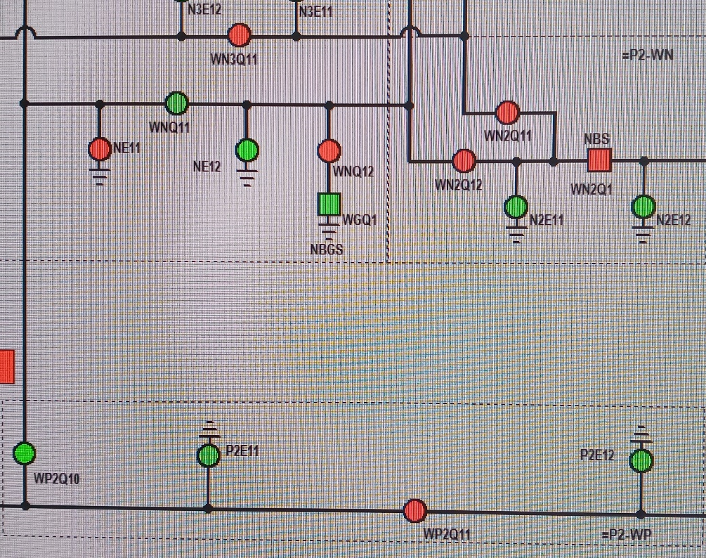
Pole 2 deblock: Step 4
4. Close Pole 2 Bus Switch WP2Q11
This switch is also closed during the same command “DC Sequence connect P2”.
Check the switch is indeed closed and the position monitoring signal indication is correct.

Slide 14
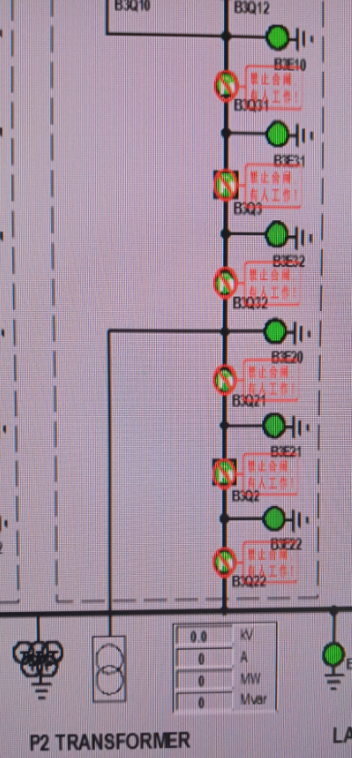
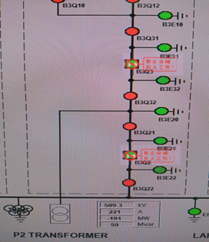
Pole 2 deblock : Step 5
5. Close Pole 2 Transformer B.B. 1 and B.B. II Isolators B3Q22, B3Q21, B3Q31, B3Q32
Close Isolator control power switch and motor power switch
Close Isolator using Operator Workstation Interface
Check three-phase switch is indeed closed and the position monitoring signal indication is correct
Open Isolator control power switch and motor power switch

Slide 15
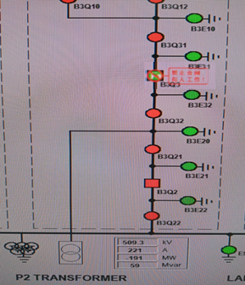
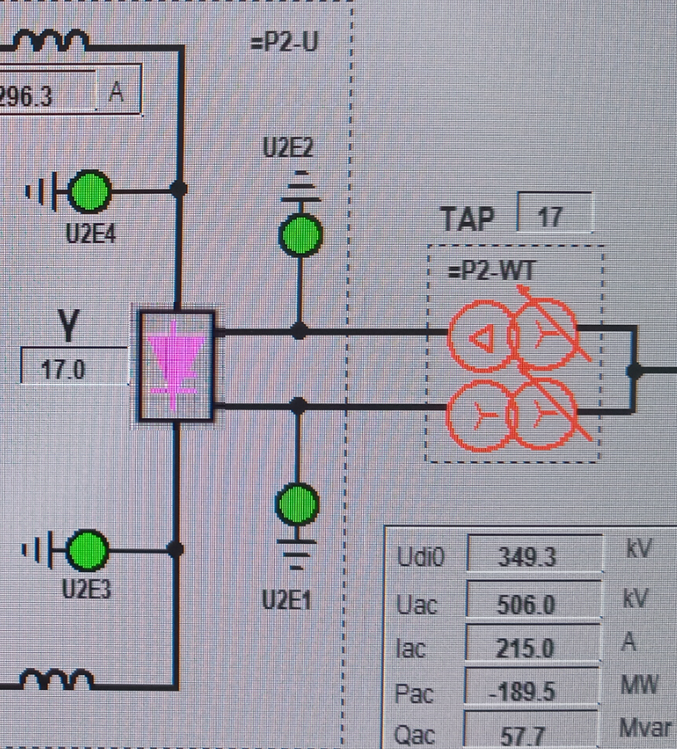
Pole 2 deblock : Step 6
6. Close B.B. 1I Breaker B3Q2 to Energize Pole 2 Converter Transformer
Close B3Q2 Circuit Breaker using Operator Workstation Interface
Check B3Q2 mechanical position indicator is correct and control signal indication is correct

Slide 16
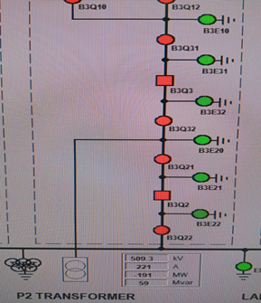
Pole 2 deblock : Step 7
7. Close Pole 2 Converter Transformer B.B. 1 Breaker B3Q3
Close B3Q3 Circuit Breaker using Operator Workstation Interface
Check B3Q3 mechanical position indicator is correct and control signal indication is correct

Slide 17
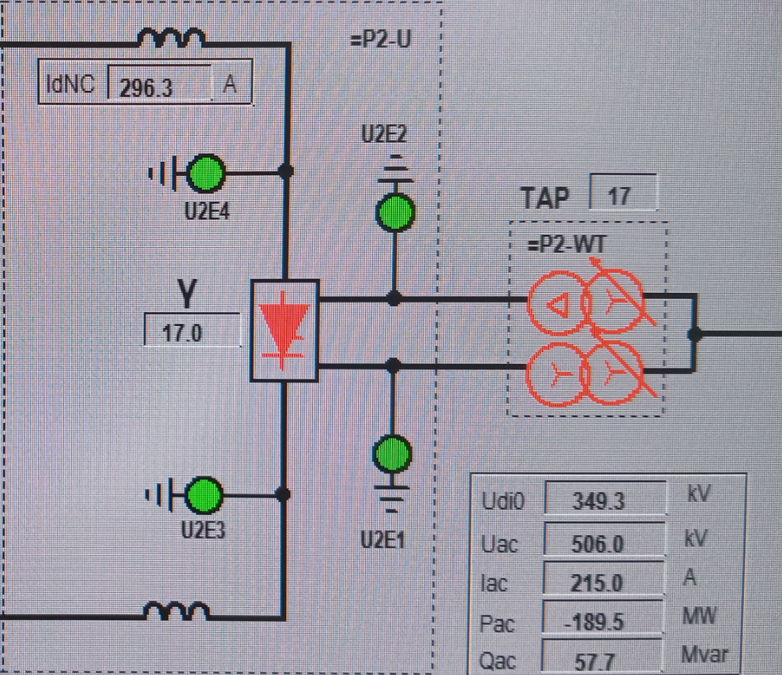
Pole 2 deblock : Step 8
8. Pole 2 Valve is in RFO state. Master Station will Deblock Pole 2 Valve

Slide 18
AC Filter SUB-BANK F1B1 Maintenance

Slide 19
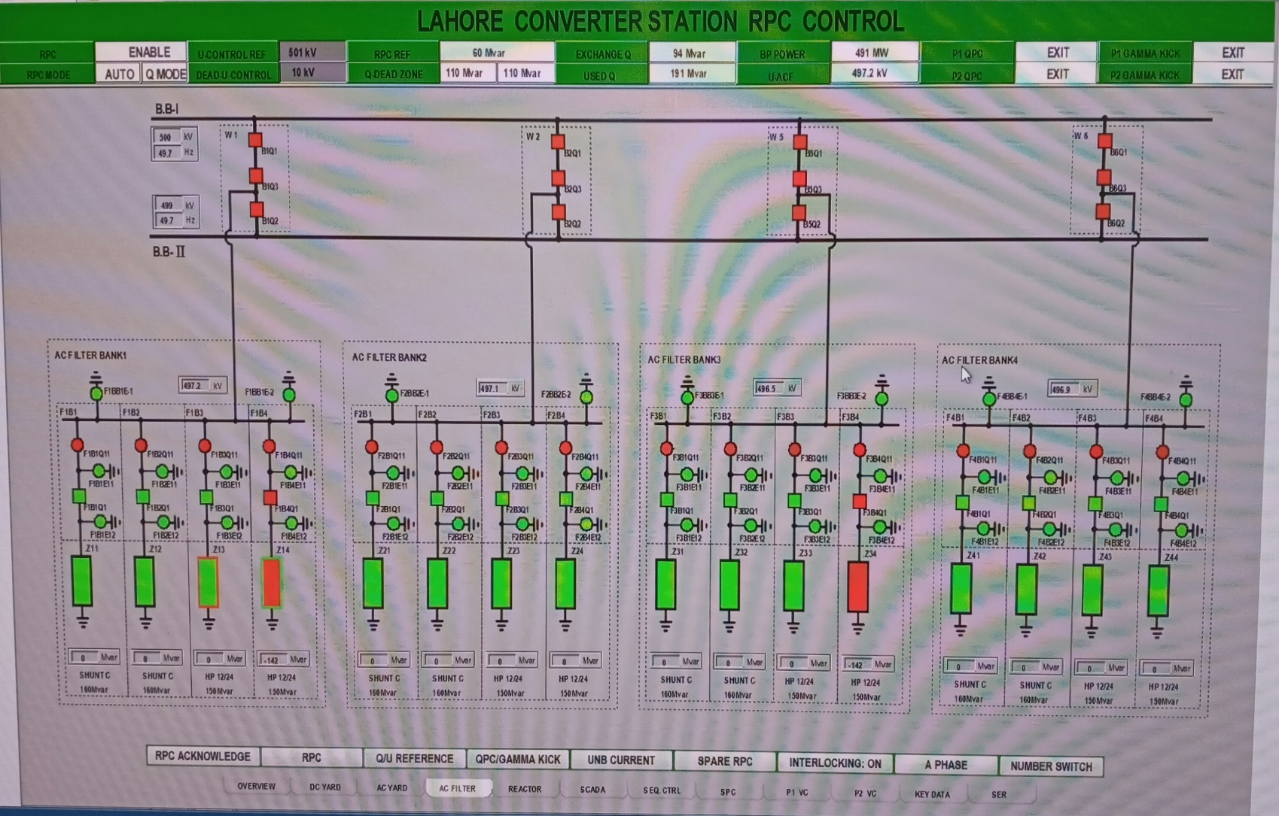
Initial State: AC Filter Yard
ACF F1B1 | Disconnected
Breaker F1B1Q1 | OPEN
Isolator F1B1Q11 | CLOSED
Earthing Switches F1B1E11, F1B1E12 | OPEN

Slide 20
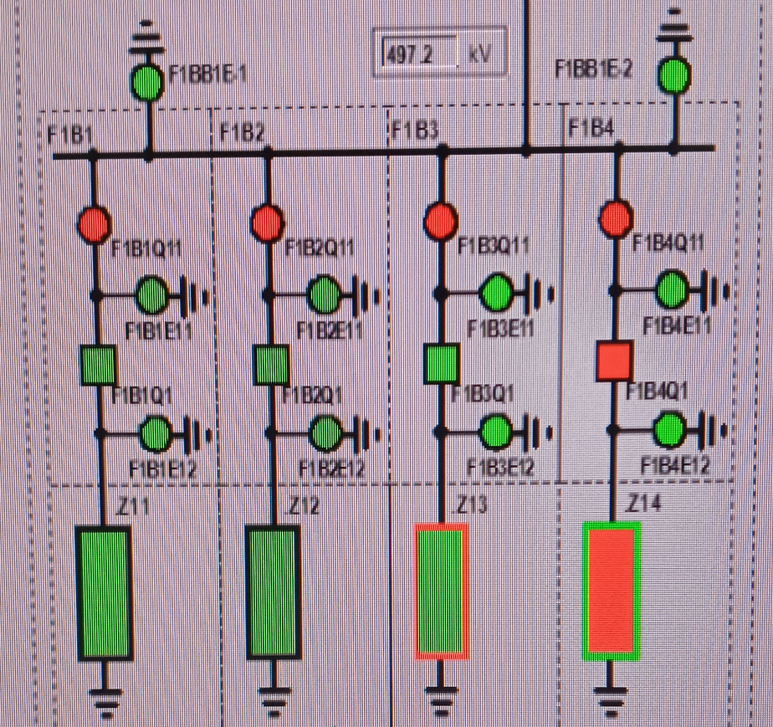
Interlocking Conditions
Operation |  | Conditions
Isolator F1B1Q11 | CLOSE | F1BB1E-1 OPEN, F1BB1E-2 OPEN F1B1E11 OPEN, F1B1E12 OPEN F1B1Q1 OPEN
 | OPEN | F1B1Q1 OPEN
Circuit Breaker F1B1Q1 | CLOSE | F1B1Q11 CLOSED SC end of discharge
 | OPEN | 1
Earthing Switch F1B1E11 | CLOSE | F1B1Q11 OPEN
Earthing Switch F1B1E12 | CLOSE | F1B1Q11 OPEN > 600s

Slide 21
F1B1 Maintenance: Step 1
Change RPC control mode from Auto to Manual. F1B1 is not connected so F1B1Q1 is already open. If F1B1 is connected, connect another filter first to replace it. Then, Open Circuit Breaker F1B1Q1.
Open F1B1Q1 Circuit Breaker using Operator Workstation Interface
Check F1B1Q1 Circuit Breaker mechanical position indicator is correct
Check F1B1Q1 control signal indication is correct

Slide 22
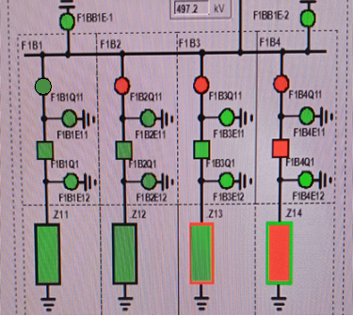
F1B1 Maintenance: Step 2
2. Open Isolator F1B1Q11
Close Isolator control power switch and motor power switch
Open Isolator using Operator Workstation Interface
Check three-phase switch is indeed open and the position monitoring signal indication is correct
Open Isolator control power switch and motor power switch

Slide 23
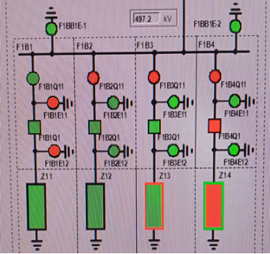
F1B1 Maintenance: Step 3
3. Close Earthing Switches F1B1E11 and F1B1E12
Change the RPC control mode to Manual mode
Close Earthing switch control power switch and motor power switch
Close Earthing switch using Operator Workstation Interface
Check three-phase switch is indeed closed and the position monitoring signal indication is correct
Open Earthing switch control power switch and motor power switch
Change the RPC control mode back to Auto from Manual after the operation is complete.

Slide 24
B1Q1 Maintenance

Slide 25
Initial State: AC Yard
Pole 1 Transformer | Connected
B.B. Breakers B1Q1 | CLOSED
Isolators B1Q11, B1Q12 | CLOSED
Earth Switches B1E11, B1E12 | OPEN

Slide 26
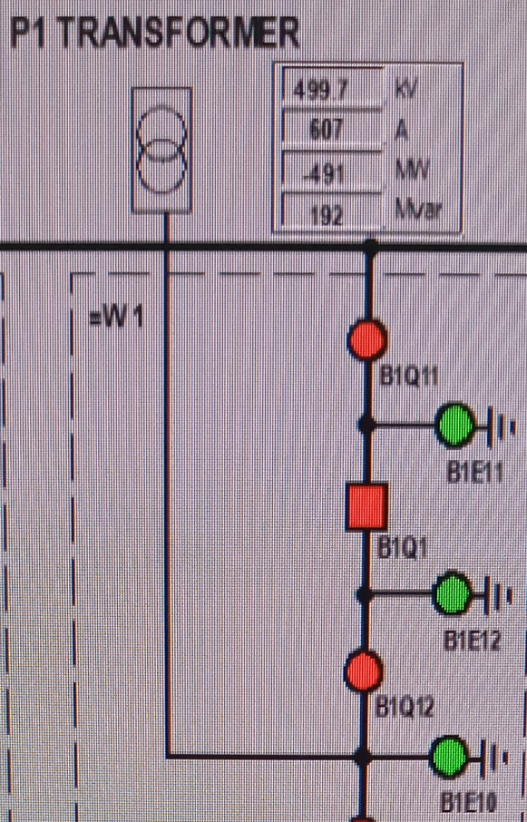
Interlocking Conditions
Operation |  | Conditions
Isolator B1Q11, B1Q12 | CLOSE | B1Q1 OPEN, B1E11 & B1E12 OPEN
 | OPEN | B1Q1 OPEN
Circuit Breaker B1Q1 | CLOSE | B1Q11 CLOSED, B1Q12 CLOSED
 | OPEN | 1
Earthing Switch B1E11 | CLOSE | B1Q11 OPEN, B1Q12 OPEN
Earthing Switch B1E12 | CLOSE | B1Q11 OPEN, B1Q12 OPEN

Slide 27
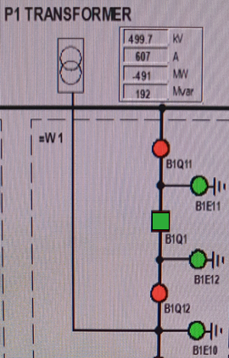
B1Q1 Maintenance: Step 1
Open B1Q1 circuit breaker
Open B1Q1 Circuit Breaker using Operator Workstation Interface
Check B1Q1 Circuit Breaker mechanical position indicator is correct
Check B1Q1 control signal indication is correct

Slide 28
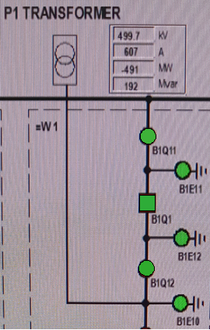
B1Q1 Maintenance: Step 2
2. Open Isolators B1Q11 and B1Q12
Close Isolator control power switches and motor power switches
Open Isolators using Operator Workstation Interface
Check three-phase switches are indeed open and the position monitoring signal indications are correct
Open Isolator control power switches and motor power switches

Slide 29
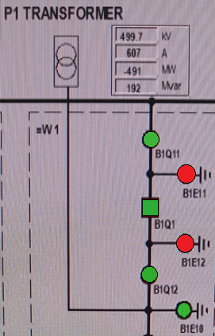
B1Q1 Maintenance: Step 3
3. Close Earthing Switches B1E11 and B1E12
Close Earthing switch control power switch and motor power switch
Close Earthing switch using Operator Workstation Interface
Check three-phase switch is indeed closed and the position monitoring signal indication is correct
Open Earthing switch control power switch and motor power switch

Slide 30
Lahore SOUTH-I Line Maintenance

Slide 31
Initial State: AC Yard
Lahore South 1 Line | Connected
B.B. Breakers B2Q1, B2Q3 | CLOSED
Isolators B2Q10, B2Q11,B2Q12, B2Q31,B2Q32 | CLOSED
Earth Switches B2E10, B2E30, B2E11, B2E12, B2E31, B2E32 | OPEN

Slide 32
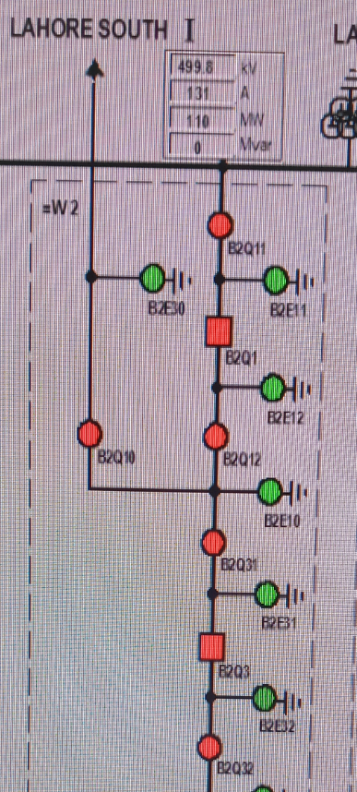
Interlocking Conditions
Operation |  | Conditions
Isolator B2Q11, B2Q12 | CLOSE | B2Q1 OPEN, B2E11 & B2E12 Open
 | OPEN | B2Q1 OPEN
Isolator B2Q31, B2Q32 | CLOSE | B2Q3 OPEN, B2E31 & B2E32 Open
 | OPEN | B2Q3 OPEN
Circuit Breaker B2Q1 | CLOSE | B2Q11 CLOSED, B2Q12 CLOSED
 | OPEN | 1
Circuit Breaker B2Q3 | CLOSE | B2Q31 CLOSED, B2Q32 CLOSED
 | OPEN | 1
Earthing Switch B2E11, B2E12 | CLOSE | B2Q11 OPEN, B2Q12 OPEN
Earthing Switch B2E31, B2E32 | CLOSE | B2Q31 OPEN, B2Q32 OPEN

Slide 33
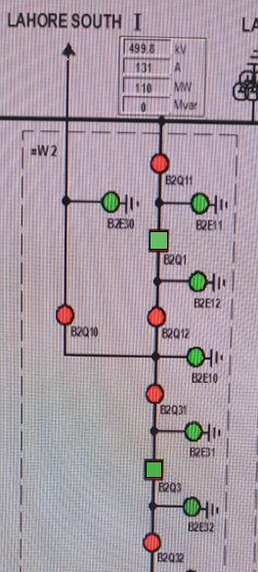
Lahore S-I Maintenance: Step 1
Open Circuit Breakers B2Q3 and B2Q1
First open B2Q3 middle breaker than B2Q1.
Open Circuit Breaker using Operator Workstation Interface
Check Circuit Breaker mechanical position indicator is correct
Check control signal indication is correct

Slide 34
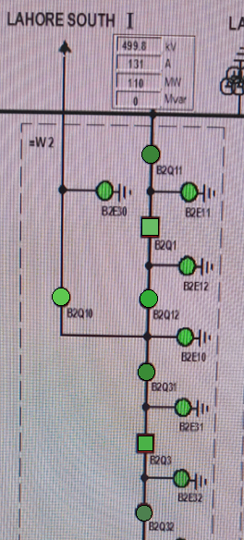
Lahore S-I Maintenance: Step 2
2. Open Isolators B2Q11, B2Q12, B2Q31 B2Q32 and B2Q10
Sequence of operation will be B2Q10>B2Q12>B2Q31>B2Q11>B2Q31
Close Isolator control power switch and motor power switch
Open Isolator using Operator Workstation Interface
Check three-phase switch is indeed open and the position monitoring signal indication is correct
Open Isolator control power switch and motor power switch

Slide 35
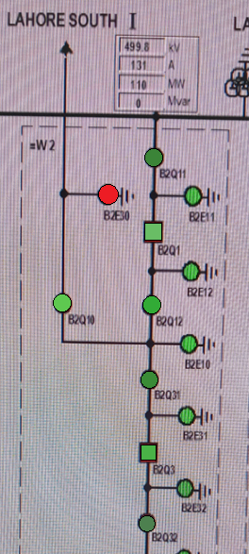
Lahore S-I Maintenance: Step 3
3. Contact Lahore South I Station. After permission, close Earthing Switch B2E30
Close Earthing switch control power switch and motor power switch
Close Earthing switch using Operator Workstation Interface
Check three-phase switch is indeed closed and the position monitoring signal
indication is correct
Open Earthing switch control power switch and motor power switch

Slide 36
Lahore S-I Maintenance: Step 4
4. Open the Line PT secondary MCB from PT box in the yard.
Find the secondary circuit MCB of CVT11, CVT12 and CVT13 and must open them.

Slide 37
132kV Line 2 Maintenance

Slide 38
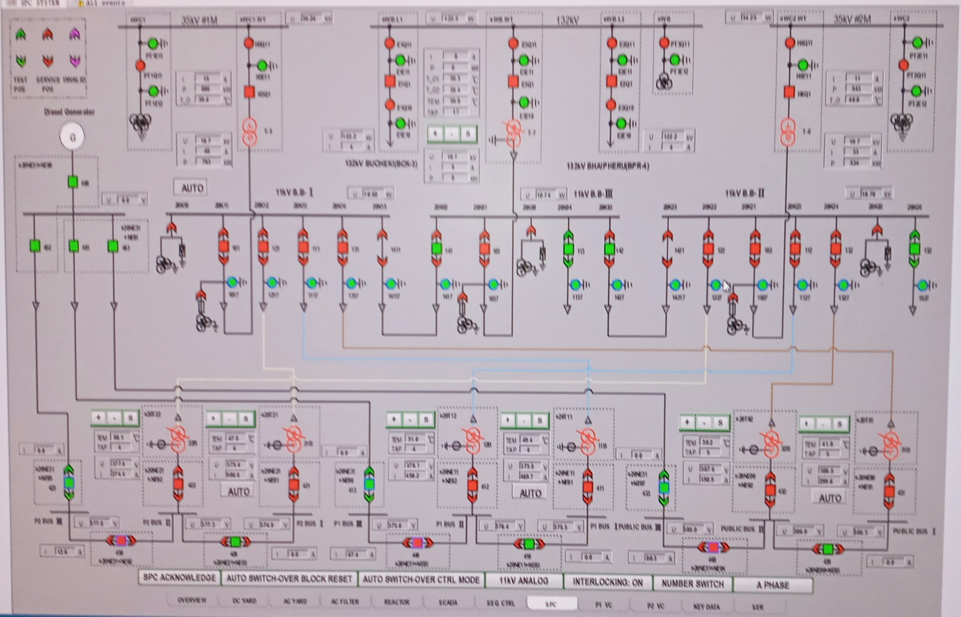
INITIAL State: SPC
132 kV Line 2 | Connected
Breaker E2Q1 | CLOSED
Isolators E2Q10,E2Q11 | CLOSED
Earthing Switches E2E10, E2E11 | OPEN

Slide 39
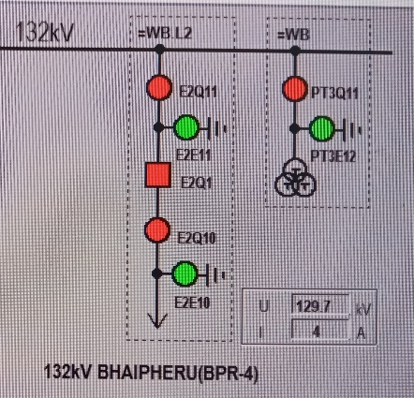
Interlocking Conditions
Operation |  | Conditions
Isolator E2Q11, E2Q12 | CLOSE | E2Q1 OPEN
 | OPEN | E2Q1 OPEN
Circuit Breaker E2Q1 | CLOSE | E2Q11 CLOSED, E2Q12 CLOSED
 | OPEN | 1
Earthing Switch E2E10 | CLOSE | E2Q11 OPEN, E2Q12 OPEN
Earthing Switch E2E11 | CLOSE | E2Q11 OPEN, E2Q12 OPEN

Slide 40
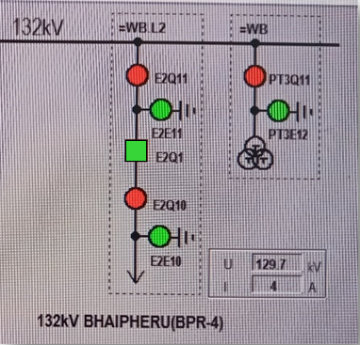
132kV Line 2 Maintenance: Step 1
Close 132kV line 2 E2Q1 circuit breaker
Close E2Q1 Circuit Breaker using Operator Workstation Interface
Check 132kV Line 2 three phases have no voltage (Indirect power check)
Check E2Q1 Circuit Breaker mechanical position indicator is correct
Check E2Q1 control signal indication is correct

Slide 41
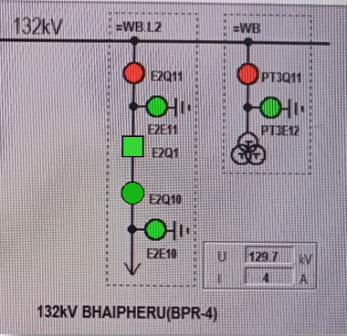
132kV Line 2 Maintenance: Step 2
2. Open 132kV line 2 E2Q10 Isolator
Close E2Q10 Isolator control power switch and motor power switch
Open E2Q10 Isolator using Operator Workstation Interface
Check E2Q10 three-phase switch is indeed open and the position monitoring signal indication is correct
Open E2Q10 isolator control power switch and motor power switch

Slide 42
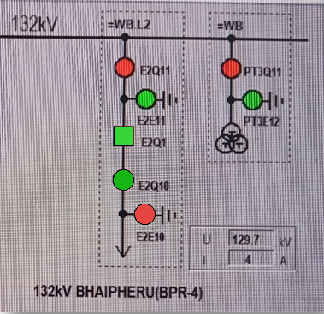
132kV Line 2 Maintenance: Step 3
3. Call RCC for permission to close E2E10. After they give permission, check there is no power on 132kV line 2. Then, close 132kV line 2 E2E10 Earthing switch
Close E2E10 Earthing switch control power switch and motor power switch
Close E2E10 Earthing switch using Operator Workstation Interface
Check E2E10 three-phase switch is indeed closed and position monitoring signal indication is correct
Open E2E10 Earthing switch control power switch and motor power switch

Slide 43
132kV Line 2 Maintenance: Step 4
4. Open secondary voltage switch in the 132kV line 2 control cabinet.
Check the name of the box and air switch. Open secondary voltage switch.
Strictly implement the guardianship and read-back system on site

